Slide 1
Chapter 8 – Naïve Bayes
Data Mining for Business Analytics in R
Shmueli, Bruce, Yahav, Patel & Lichtendahl

Slide 2
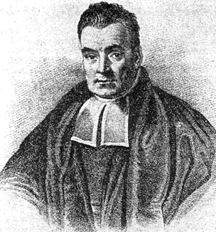
Characteristics
Data-driven, not model-driven
Makes no assumptions about the data
Named after mid-16th century English statistician and Presbyterian minister Thomas Bayes

Slide 3
Naïve Bayes: The Basic Idea
For a given new record to be classified, find other records like it (i.e., same values for the predictors)
What is the prevalent class among those records?
Assign that class to your new record

Slide 4
Usage
Requires categorical variables
Numerical variable must be binned and converted to categorical
Can be used with very large data sets
Example: Spell check programs assign your misspelled word to an established “class” (i.e., correctly spelled word)

Slide 5
Exact Bayes Classifier
Relies on finding other records that share same predictor values as record-to-be-classified.
Want to find “probability of belonging to class C, given specified values of predictors.”
Even with large data sets, may be hard to find other records that exactly match your record, in terms of predictor values.

Slide 6
Solution – Naïve Bayes
Assume independence of predictor variables (within each class)
Use multiplication rule
Find same probability that record belongs to class C, given predictor values, without limiting calculation to records that share all those same values

Slide 7
Calculations
Take a record, and note its predictor values
Find the probabilities those predictor values occur across all records in C1
Multiply them together, then by proportion of records belonging to C1
Same for C2, C3, etc.
Prob. of belonging to C1 is value from step (3) divide by sum of all such values C1 … Cn
Establish & adjust a “cutoff” prob. for class of interest

Slide 8
Example: Financial Fraud
Target variable: Audit finds fraud, no fraud
Predictors:
Prior pending legal charges (yes/no)
Size of firm (small/large)

Slide 10
Exact Bayes Calculations
Goal: classify (as “fraudulent” or as “truthful”) a small firm with charges filed
There are 2 firms like that, one fraudulent and the other truthful
P(fraud | charges=y, size=small) = ½ = 0.50
Note: calculation is limited to the two firms matching those characteristics

Slide 11
Naïve Bayes Calculations
Same goal as before
Compute 2 quantities:
Proportion of “charges = y” among frauds, times proportion of “small” among frauds, times proportion frauds = 3/4 * 1/4 * 4/10 = 0.075
Prop “charges = y” among frauds, times prop. “small” among truthfuls, times prop. truthfuls = 1/6 * 4/6 * 6/10 = 0.067
P(fraud | charges, small) = 0.075/(0.075+0.067)
= 0.53

Slide 12
Naïve Bayes, cont.
Note that probability estimate does not differ greatly from exact
All records are used in calculations, not just those matching predictor values
This makes calculations practical in most circumstances
Relies on assumption of independence between predictor variables within each class

Slide 13
Independence Assumption
Not strictly justified (variables often correlated with one another)
Often “good enough” – ranking of probabilities is more important than unbiased estimate of actual probabilities

Slide 14
Naïve Bayes in R
Use package e1071
Function naiveBayes
See Table 8.4 for code for running Naïve Bayes
Includes code for binning numeric variables into categories, which is required for NB

Slide 15
Advantages
Handles purely categorical data well
Works well with very large data sets
Simple & computationally efficient

Slide 16
Shortcomings
Requires large number of records
Problematic when a predictor category is not present in training data
Assigns 0 probability of response, ignoring information in other variables

Slide 17
On the other hand…
Probability rankings are more accurate than the actual probability estimates
Good for applications using lift (e.g. response to mailing), less so for applications requiring probabilities (e.g. credit scoring)

Slide 18
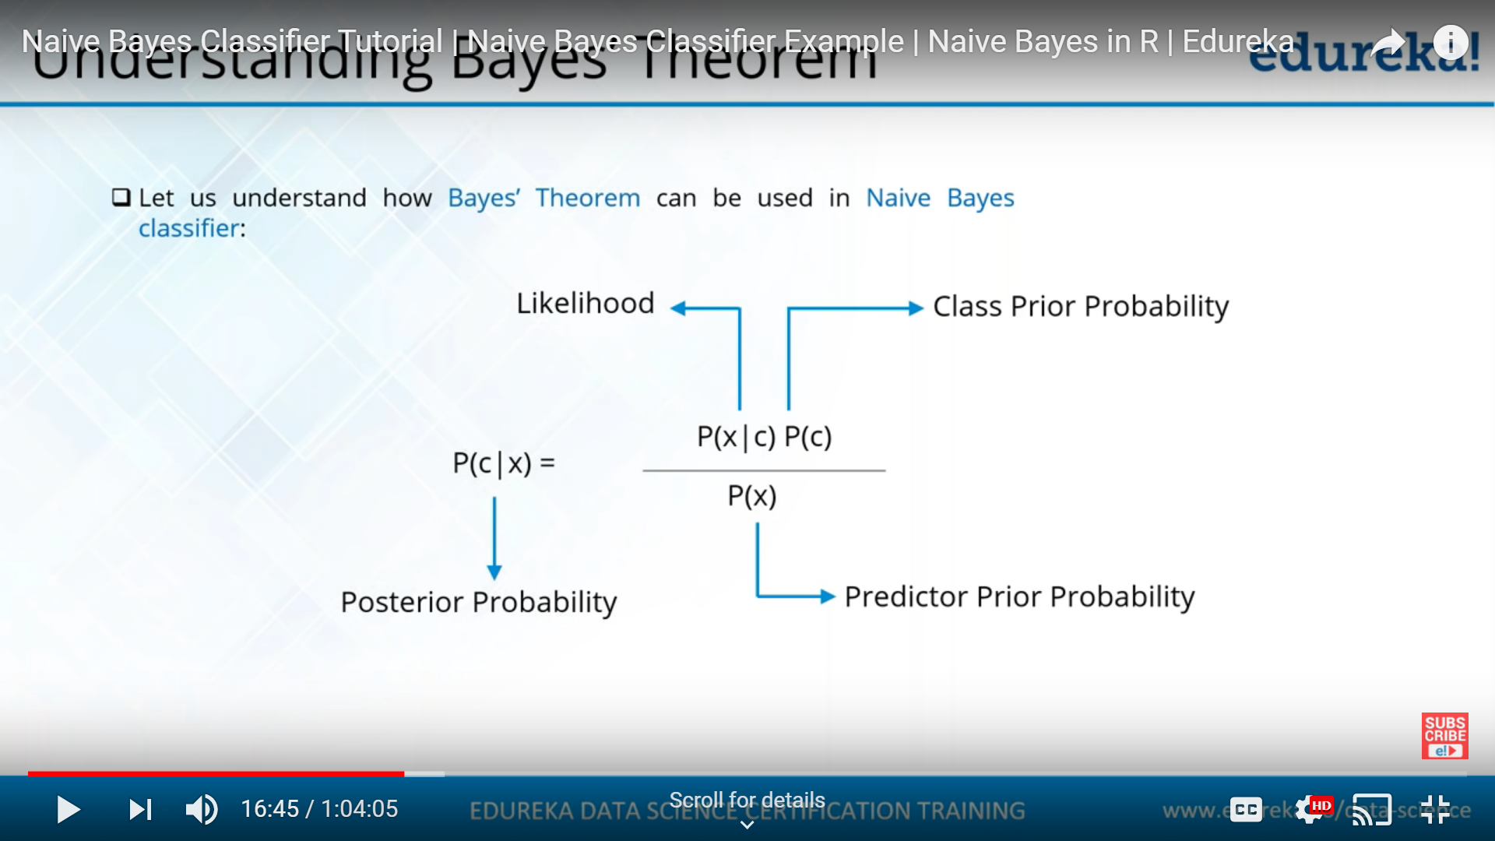
Bayes’ Theorem

Slide 19
Another Example of the Naïve Bayes Classifier
The weather data, with counts and probabilities
outlook |  |  | temperature |  |  | humidity |  |  | windy |  |  | play
 | yes | no |  | yes | no |  | yes | no |  | yes | no | yes | no
sunny | 2 | 3 | hot | 2 | 2 | high | 3 | 4 | false | 6 | 2 | 9 | 5
overcast | 4 | 0 | mild | 4 | 2 | normal | 6 | 1 | true | 3 | 3
rainy | 3 | 2 | cool | 3 | 1
sunny | 2/9 | 3/5 | hot | 2/9 | 2/5 | high | 3/9 | 4/5 | false | 6/9 | 2/5 | 9/14 | 5/14
overcast | 4/9 | 0/5 | mild | 4/9 | 2/5 | normal | 6/9 | 1/5 | true | 3/9 | 3/5
rainy | 3/9 | 2/5 | cool | 3/9 | 1/5
A new day
outlook | temperature | humidity | windy | play
sunny | cool | high | true | ?

Slide 20
Prediction
Likelihood of yes
Likelihood of no
Probability of yes: =(0.0053)/(0.0053+0.0206)
=0.20458
Probability of no: =(0.0206)/(0.0053+0.0206)
= 0.795
Therefore, the prediction is No

Slide 21
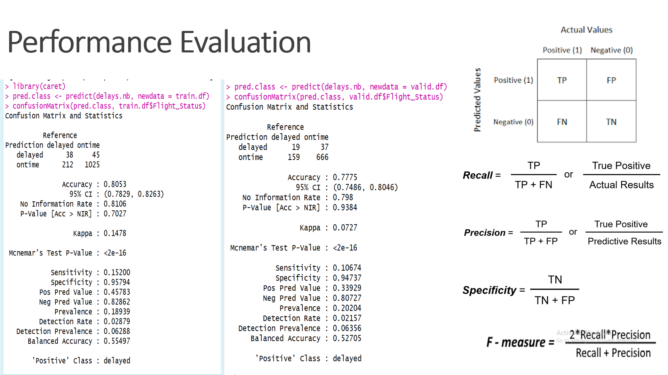

Slide 22
Summary
No statistical models involved
Naïve Bayes (like KNN) pays attention to complex interactions and local structure
Computational challenges remain

